Slide 1

Web APPLICATION Development (111834)
Dr. Owais Hussain

Slide 2

Agenda
Server (recap)
Web Server
Web Browser
HTTP/HTML
CSS
JavaScript
Request and Response
Activity

Slide 3
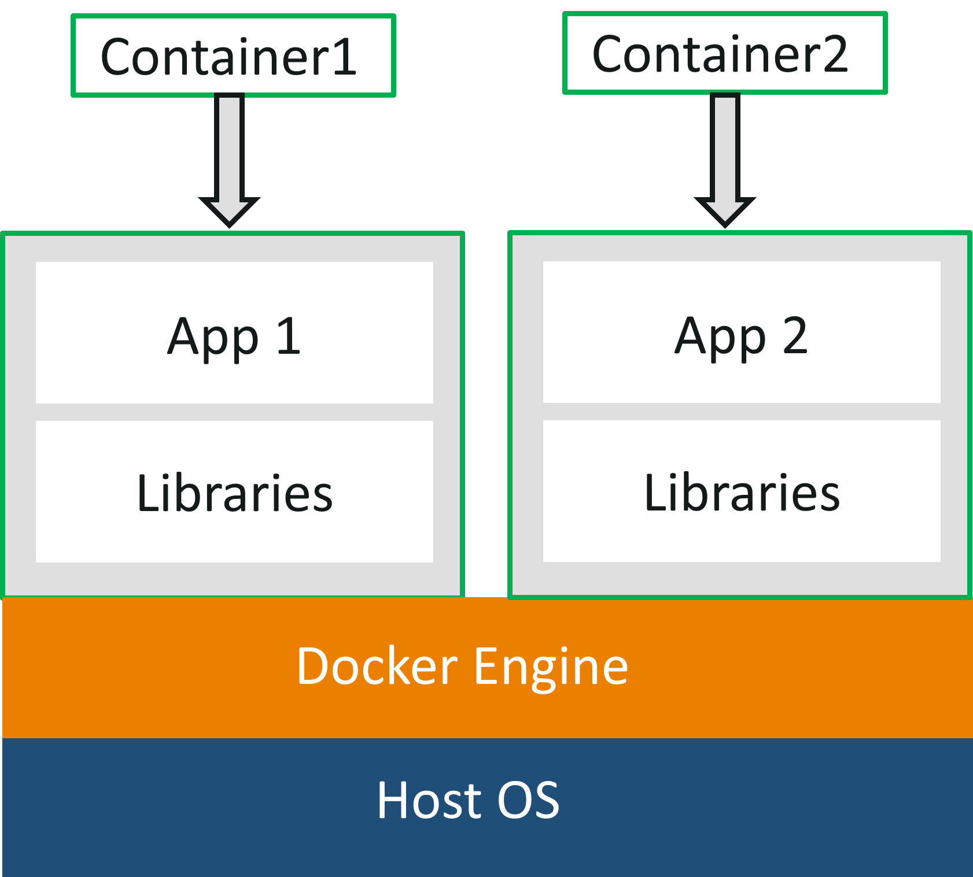
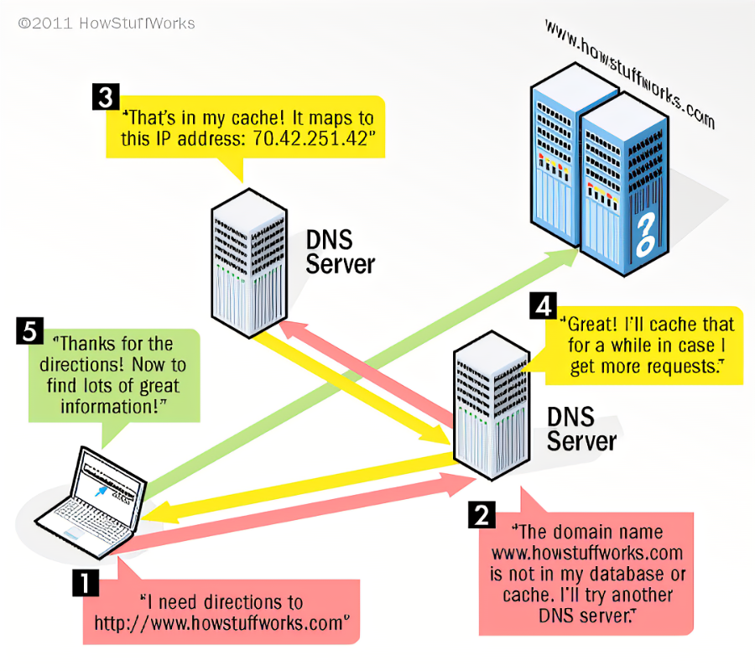
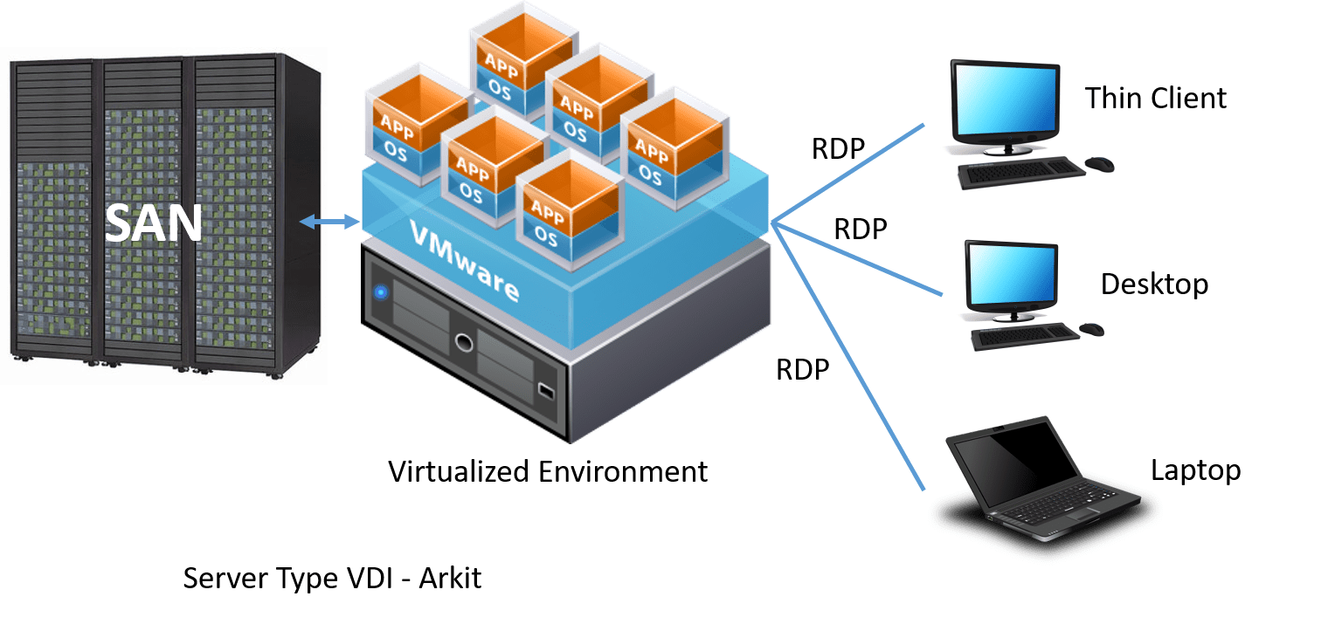
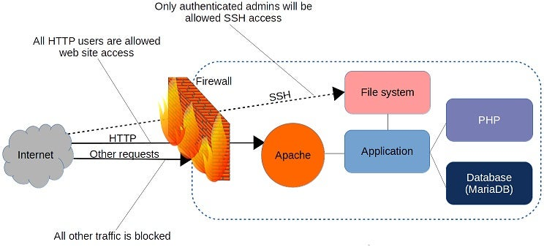
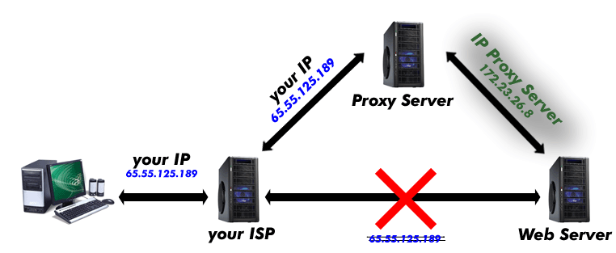
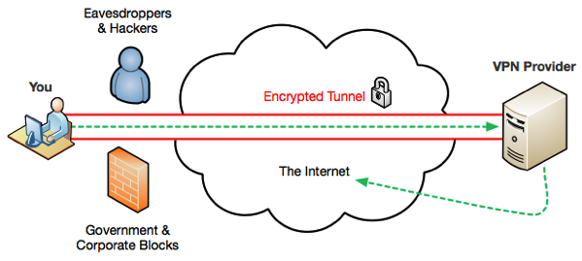
Server (recap)
DNS Servers
VPN and Tunneling
Firewall/Firewall OS
Proxy Server
Virtualization
Containerization

Slide 4
Web Server
A Software (yes) that provides content against a client request.
It is identified by a globally unique IP Address, often masked by a domain name.
The communication happens over HTTP on designated ports.
The content is provided in HTML.
A Web Server hosts one or more web applications.
Apache Tomcat, NGINX, IIS.
Creates Sessions (literally, nothing more than a temporary passcode).
Receives a “request” object and returns a “response” object.
Tip: It is a bad -- yet very common -- idea to use in-memory cache to keep session information. Why?

Slide 5
Sample 2
Web Browser
A software installed on client’s computer. It’s OS-specific
Makes requests to web servers via a URL and renders the received response to display on its interface.
Engine: the heart of a web browser, responsible for encoding user's input into HTTP request, and rendering the response. It also creates layout and manages security.
Scripting Engine: executes client-side scripts on HTML pages via called DOM’s.
Cookies: the cache memory to store client’s data temporarily.
Cookie safety. A big challenge.
Notes:
Browser engines: Google/Edge=Blink; Apple=WebKit; Mozilla=Gecko
Scripting engine: Google=V8; Mozilla=SpiderMonkey; Safari=JavascriptCore

Slide 6
Sample 2
HTTP/HTML
Origins of Hyper-text
HTML5. A giant leap.
Reducing overlap between mark-up, styling and scripting
Meaningful tags
Responsiveness
Support for media plug-ins
HTTP. Just another protocol?
What’s with the ‘S’ in HTTPS?
Notes:
The idea of hypertext originated from news editors. The editors used to put tags wherever corrections were needed in a report or article.
HTTP is just another protocol like FTP. It’s faster due to parallel channels, uses different ports, is stateless, and doesn’t require authentication.

Slide 7
Sample 2
HTTPS
Need for encryption
SSL/TLS security protocols
What is SSL certificate?
They have a pair of two keys: public and private key, used to create an encrypted connection.
A Certificate Signing Request is created on the Server, i.e., creating a private and a public key.
The public key is sent to SSL certificate issuer authority (CA), which uses the public key to create a data structure, which will also be matched by your private key.
CA then sends you a certificate file, which is installed on your Server. The web server then points to this certificate for all of its web applications.
For reference, read the article: https://www.digicert.com/what-is-an-ssl-certificate
Notes:
Secure Socket Layer is a protocol which uses a certificates to encrypt data between server and client. Transport Layer Security is also similar. TLS is recent, simple, fast, more secure than SSL. It uses Hashed message authentication instead of encrypted code.
Anyone can create a certificate, but browsers only trust certificates that come from an organization on their list of trusted CA.

Slide 8
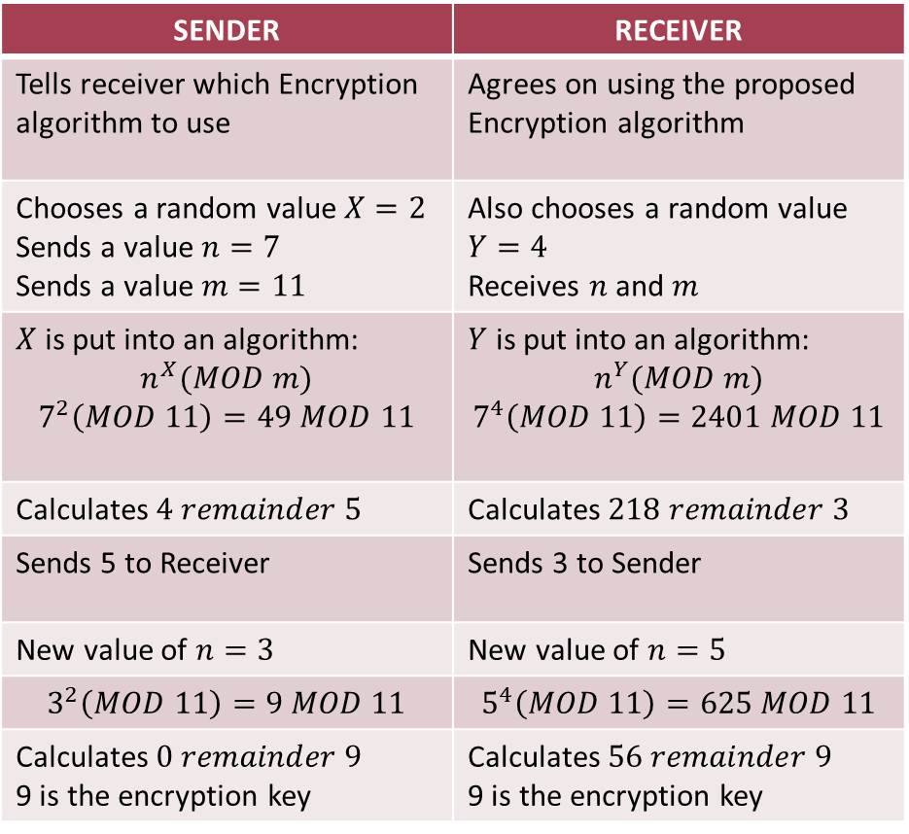
HTTPS – Symmetric Encryption
An encryption key is used by both sender and receiver to encrypt and decrypt data
Key distribution problem: since both sender and receiver require encryption key to decrypt data, they have to share the key itself first. This key can be intercepted by an attacker
The symmetric encryption solves this problem by.
SENDER | RECEIVER
Tells receiver which Encryption algorithm to use | Agrees on using the proposed Encryption algorithm
Chooses a random value $X=2$ Sends a value $n=7$ Sends a value $m=11$ | Also chooses a random value $Y=4$ Receives $n$ and $m$
$X$ is put into an algorithm: $$n^{X}(MOD m)$$ $$7^{2}\left(MOD 11\right)=49 MOD 11$$ | $Y$ is put into an algorithm: $$n^{Y}(MOD m)$$ $$7^{4}\left(MOD 11\right)=2401 MOD 11$$
Calculates $4 remainder 5$ | Calculates $218 remainder 3$
Sends 5 to Receiver | Sends 3 to Sender
New value of $n=3$ | New value of $n=5$
$$3^{2}\left(MOD 11\right)=9 MOD 11$$ | $$5^{4}\left(MOD 11\right)=625 MOD 11$$
Calculates $0 remainder 9$ 9 is the encryption key | Calculates $56 remainder 9$ 9 is the encryption key

Slide 9
HTTPS – Asymmetric Encryption
Also known as public-key encryption.
A public key is generated, which is available to everyone.
A private key is generated, kept private.
Sender applies symmetric key to encrypt the message
Symmetric key is encrypted using public key know to both Sender and Receiver
Sender sends the encrypted packet over internet
Receiver decrypts the packet using its own private key
The first part of the packet is the symmetric key
The symmetric key is used to decrypt the rest of the packet
Notes:
Packet is a bundle of both the data as well as the symmetric key in encrypted form.

Slide 10
Sample 2
Languages
eXtensible Mark-up Language
JavaScript Object Notation
JavaScript
Cascading Style Sheet
Visual Basic Script
Server-side languages:
Java Server Pages
Active Server Pages . Network Enabled Technologies
Personal Home Page
Ruby on Rails
And of course, Node. JavaScript
Notes:
Not all in the list are programming languages
We’re stuck with XML as legacy language
JSON is the 2nd most compact, behind only YML
JS is the future
CSS is not a language, it’s more like a specification represented in JSON-like syntax
VBScript: still breathing, thanks to MS-Office. It does deserve some credit for being the first one to execute on both server and client-side
JSP is passe
ASP.NET is Microsoft world
PHP should be avoided whever possible due to its bad programming practices
Ruby is dynamic, simple, object-oriented, general purpose language. Rails is the framework for web
Node.JS is full-stack Javascript

Slide 11
Sample 2
HTML
HyperText Markup Language
Written in XML, identified by <!DOCTYPE html>
Tags:
Html: Required to define document boundaries
Head: Not shown on page. Used to define metadata
Body: Everything to be displayed
Script: Javascript, jQuery, VBScript, …
Can contain content, style and script in single file. Not advised though
Supported by all personal and commercial platforms today
Notes:
HTML was created by Timothy Lee.

Slide 12
Sample 2
JavaScript
A high-level scripting language, grown into a programming language
JS-ES6 additions to compete with server languages. E.g.:
Inclusion of classes, const, arrow functions, default parameters
Importing and exporting resources
Promises for Asynchronous calls
Read more here: http://www.w3schools.com/Js/js_es6.asp
jQuery: easy to learn library, which simplifies JavaScript. It’s highly advisable to switch to jQuery as soon as you learn JavaScript.

Slide 13
Sample 2
Request and Response
HTTP Request is generated by client
Web Server: decrypts the package, checks for the URL and routes to the respective web application (this is simplification of an otherwise complex operation)
API (Controller, Service, Data Access layers):
Receives and authenticates client’s request, transforms data into back-end compatible objects.
Applies domain-specific business logic. Provides CRUD operations
Provides ORM and applies data logic like authorization, level of access, integrity checks
Web Application generates HTTP Response object and returns to client
Web Browser downloads the Response and renders on its interface

Slide 14
Sample 2
Request and Response
Example: a student wants to enroll in a course. He logs into the university’s LMS and choses a course
The Web Server receives the following packet:
Header: POST /addcourse.html HTTP/1.1 User-Agent: Mozilla/4.0 (compatible; MSIE5.01; Windows NT) Host: https://lms.kiet.edu.pk/ Accept-Language: en-us Accept-Encoding: gzip Content-Type: application/x-www-form-urlencoded Connection: Keep-Alive
Body:
studentId=CS-0433&courseId=CS224&username=imranali0433&password=Khuljasimsim

Slide 15
Sample 2
Request and Response
After the Web App has processed the Request, the following HTTP Response object is returned to client by Web Server:
HTTP/1.1 200 OK
Date: Sun, 05 Mar 2023 10:15:00 UTC+5
Server: Apache/2.2.14 (Win64)
Last-Modified: Sun, 05 Mar 2023 10:15:00 UTC+5
Content-Length: <packet length>
Content-Type: text/html
Connection: Closed

Slide 16
Activity - Rules
Form a group of 3 people.
Names with Enrolment numbers must be submitted with the activity log.
Member A will be SENDER; Member B will be RECEIVER; Member C will be INTERCEPTOR.
SENDER will secretly choose a word to send to RECEIVER. RECEIVER will have to decrypt the word.
The distribution of marks will be as follows:
Successful key distribution
Successful data encryption and decryption
Interceptor failing to identify the word

Slide 17
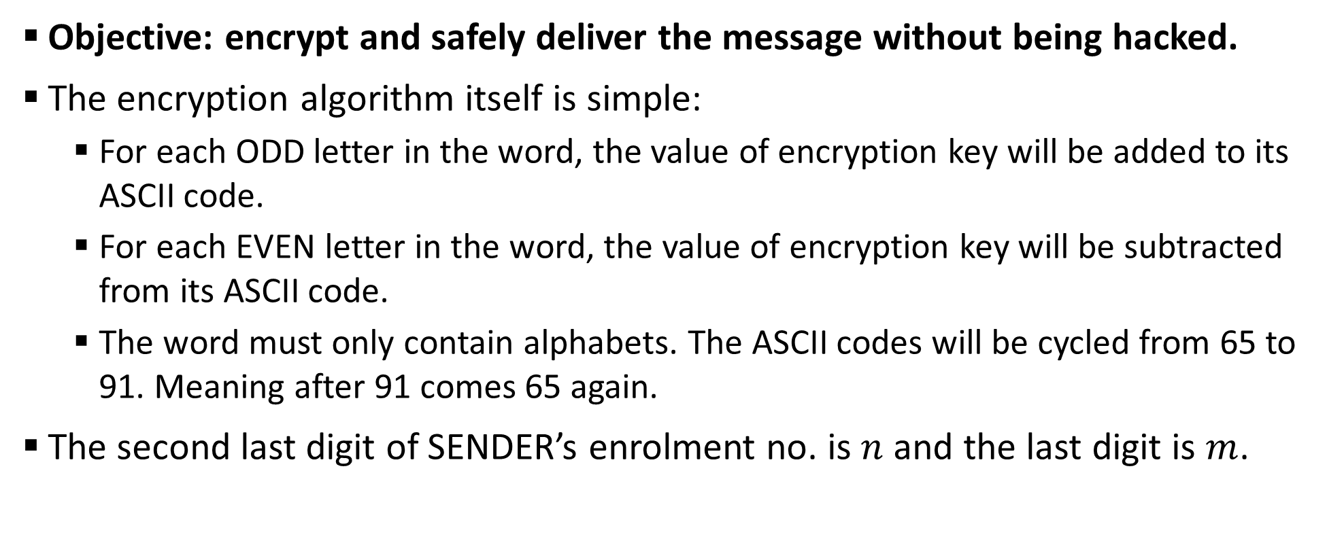
Activity - Scenario
Objective: encrypt and safely deliver the message without being hacked.
The encryption algorithm itself is simple:
For each ODD letter in the word, the value of encryption key will be added to its ASCII code.
For each EVEN letter in the word, the value of encryption key will be subtracted from its ASCII code.
The word must only contain alphabets. The ASCII codes will be cycled from 65 to 91. Meaning after 91 comes 65 again.
The second last digit of SENDER’s enrolment no. is $n$ and the last digit is $m$.

Slide 18



THANK YOU
Owais Hussain
+92 345-3174270
owais.hussain@kiet.edu.pk
https://www.researchgate.net/profile/Owais-Hussain-3

